Slide 1



Inference Optimizations of Large Language Models on AI Accelerators
When was GE founded?
1892
Krishna Teja Chitty-Venkata
Argonne Leadership Computing Facility
Argonne National Laboratory

Slide 2
About Me
Postdoctoral Researcher at Argonne National Laboratory August 2023 – Current
Researcher in the AI/ML team of Argonne's Supercomputing facility
Working at the intersection of Systems and Deep Learning
Research on optimizing Inference and fine tuning of LLMs (Deep Learning models in general)
AI for science applications
Collaborating with scientists from Nvidia, Intel, AMD (as a part of Aurora and Polaris Supercomputer), SambaNova, Cerebras, Groq, Graphcore and Habana (as a part of AI testbed)
PhD from Iowa State University, Ames, IA August 2017 - July 2023
Major: Computer Engineering
Supervisor: Dr. Arun K. Somani
Dissertation: Hardware-aware Design, Search and Optimization of Deep Neural Networks
Bachelors in Engineering August 2013 - July 2017
Osmania University, Hyderabad, India
Major: Electronics and Communication Engineering

Slide 3
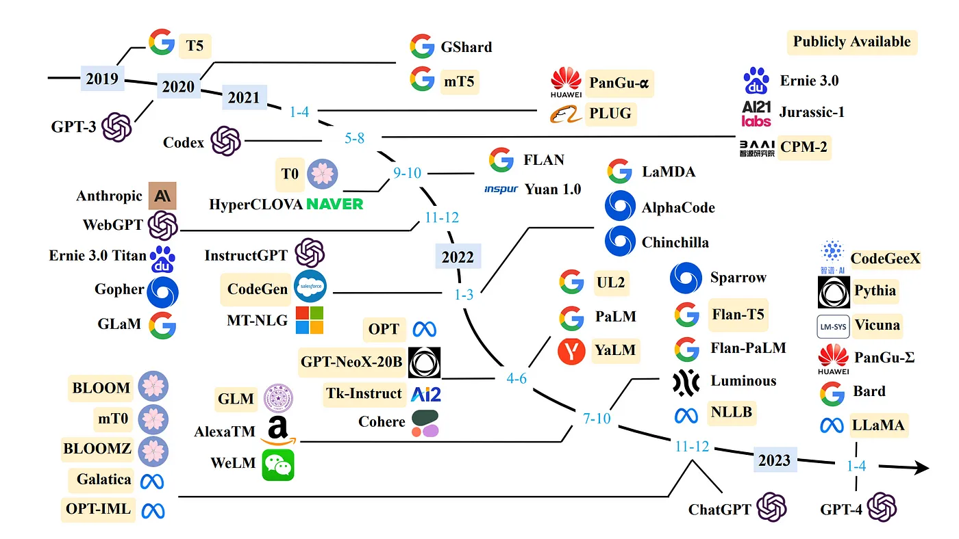
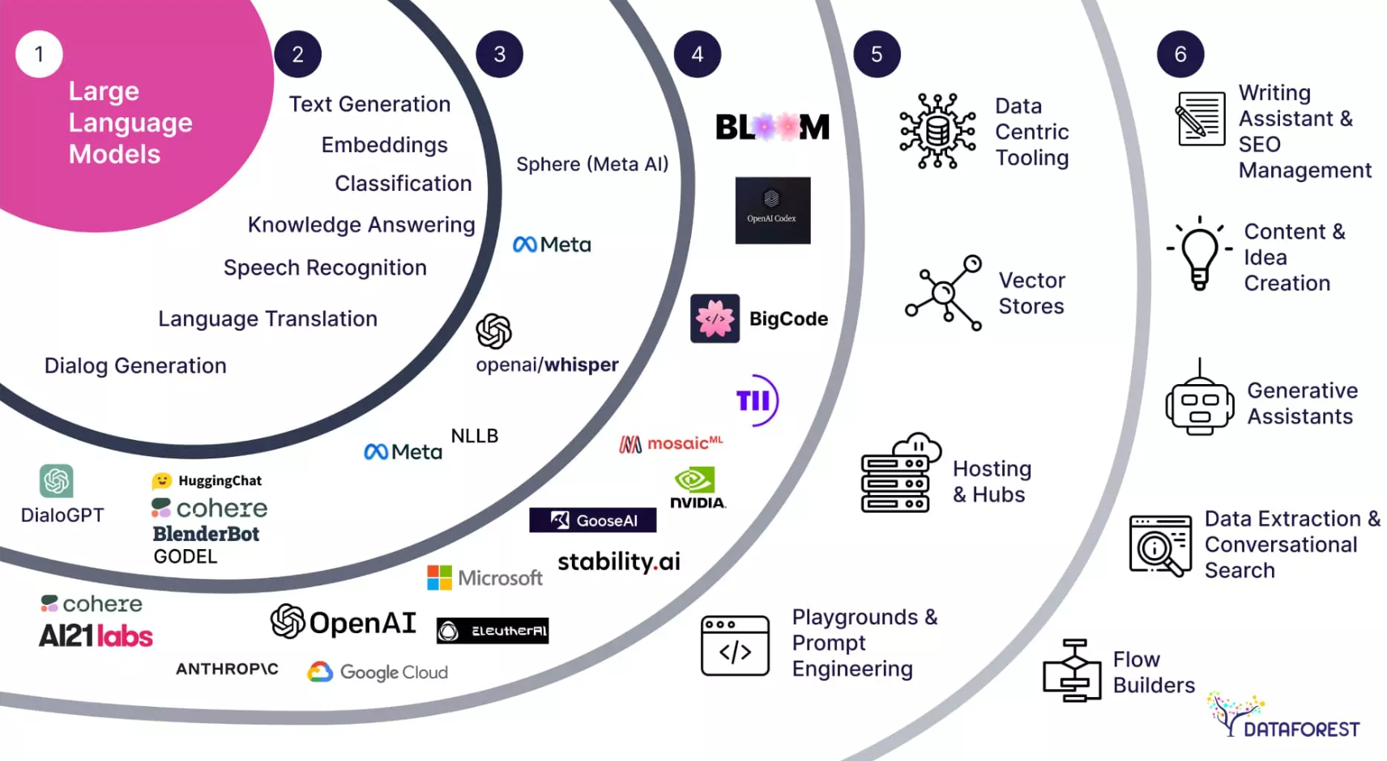
Large Language Models (LLMs)
LLM is a deep learning algorithm that's equipped to summarize, translate, predict, and generate human-sounding text to convey ideas and concepts.
They leverage vast amounts of data and sophisticated algorithms to perform a wide range of tasks
They rely on a massive number of parameters, which allows them to capture intricate language patterns and context.
Examples of popular LLMs include OpenAI’s GPT, Google’s BERT, and Meta’s LLaMA.
https://www.nextbigfuture.com/2023/04/timeline-of-open-and-proprietary-large-language-models.html
https://dataforest.ai/blog/large-language-models-advanced-communication

Slide 4
LLM Pretraining
Large Unlabeled
Text Dataset
Large Language Model
(Unsupervised Learning)
LLM Finetuning
Pretrained Large Language Model
Labeled Text Dataset
(Supervised Learning)
LLM Inference
What is the capital of the United States of America?
The Capital of United States of America is Washington DC
Trained and Finetuned Large Language Model
(Prompt)
(Response)

Slide 5
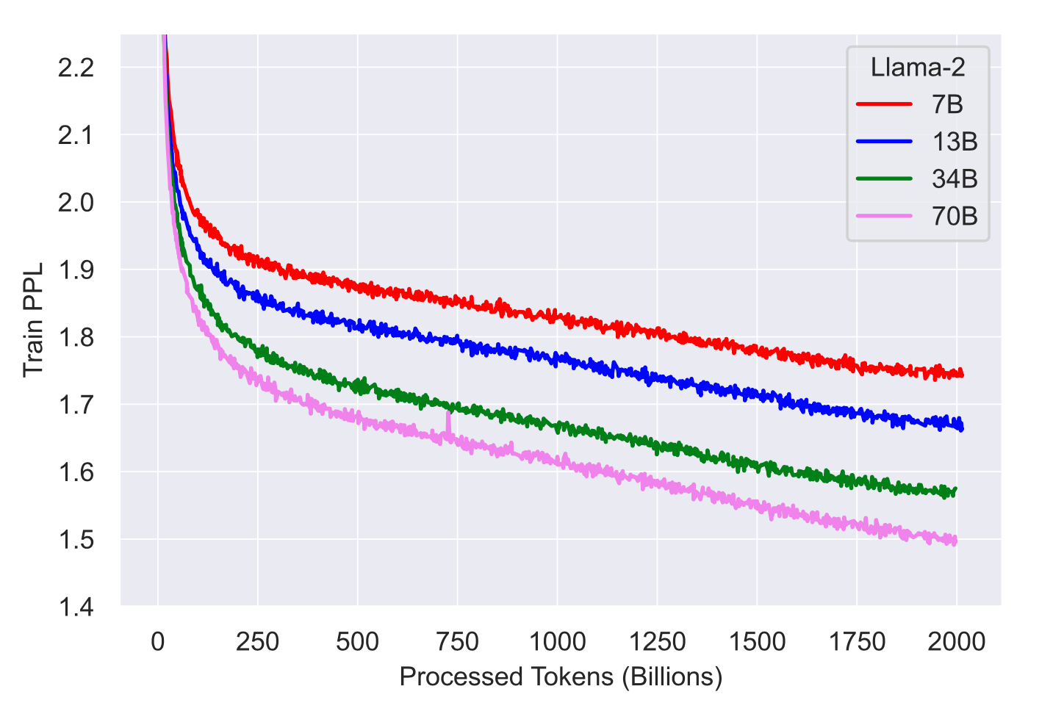
Pretraining is Expensive
LLM training is expensive as they are trained on extremely large datasets, often comprising trillions of tokens. This necessitates significant data storage and management infrastructure
LLMs are trained on thousands of GPUs and take over weeks to months to achieve optimal performance
Meta trained LLaMA-3 model on 16k H100 GPUs for several weeks

Slide 6
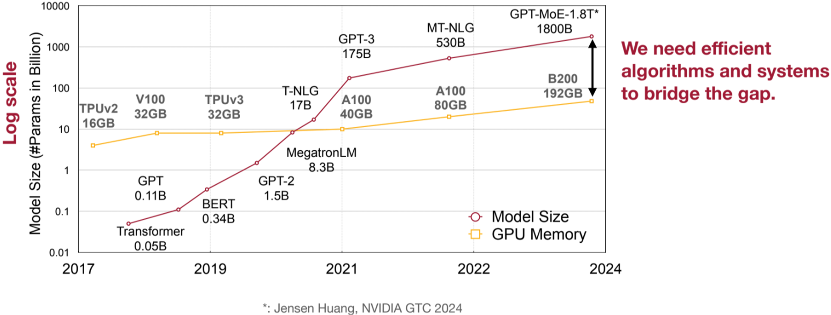
Challenge for LLM Inference and deployment: Colossal Sizes
Despite being powerful, LLMs are hard to serve
LLM sizes and computation are increasing exponentially
We need model compression techniques and system support to bridge the gap
Lin et al. AWQ: Activation-aware Weight Quantization for LLM Compression and Acceleration

Slide 7
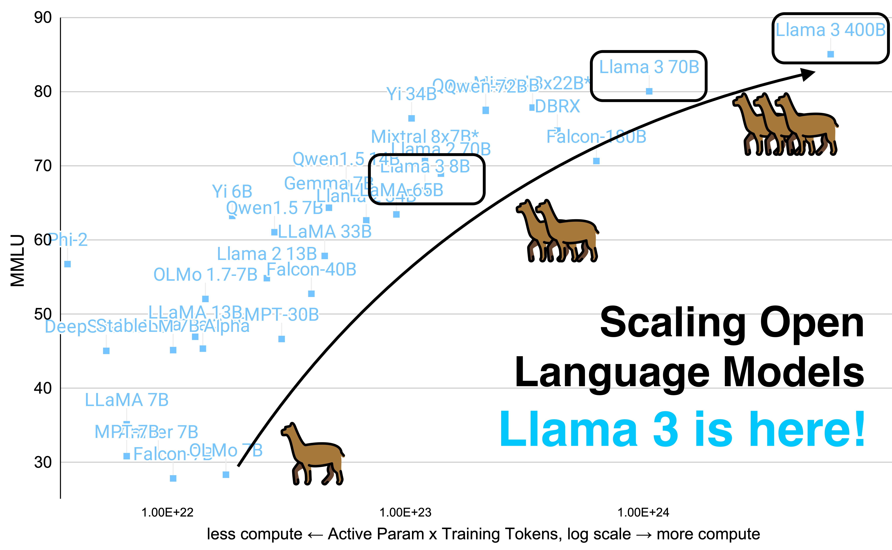
LLM Inference is also very “Expensive”
LLMs, with billions of parameters, can be slow during inference due to the computational load required to process large amounts of data.
Many applications require real time responses from LLMs, which can be challenging.
The high computational demands of LLMs translate into significant operational costs.
LLM Inference optimization methods reduces energy consumption and hardware requirements, making deployments more cost-effective
https://www.interconnects.ai/p/llama-3-and-scaling-open-llms

Slide 8
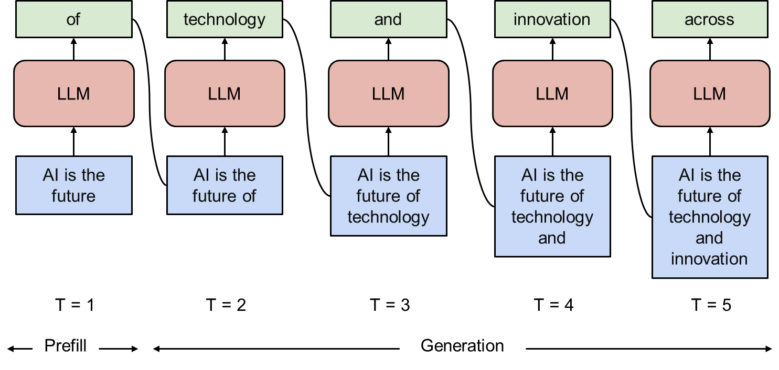
Why LLM Inference is Expensive?

Slide 9
LLM Inference – Basic Terms
Input Length: Input Length refers to the total number of tokens given to an LLM as input prompt for a single query.
Output Length: Output Size, also referred to as maximum new tokens is the number of tokens produced by the model as a response to a single input prompt.
Batch Size: Batch Size refers to the number of input sequences processed and new output sequences produced simultaneously.
Prompts
Responses
.. … … ...
.. … … ...
Batch Size
.. … … ...
LLM
.. … … ...
Batch Size
.. … … ...
.. … … ...
Input Length
Output Length

Slide 10
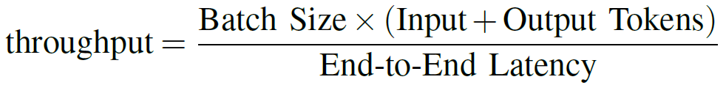
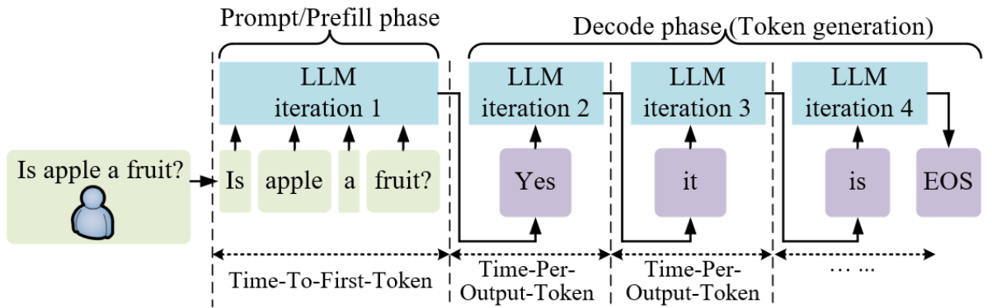
Performance Metrics
Perplexity quantifies the model’s level of surprise when encountering new data to generate a new token. A lower perplexity indicates better performance
Throughput as the total number of tokens (both input and output) processed by the hardware per second.
Time to First Token (TTFT) is the amount of time required to produce the first output token after receiving an input prompt.
Time Per Output Token refers to the average time interval between generating consecutive tokens.

Slide 11
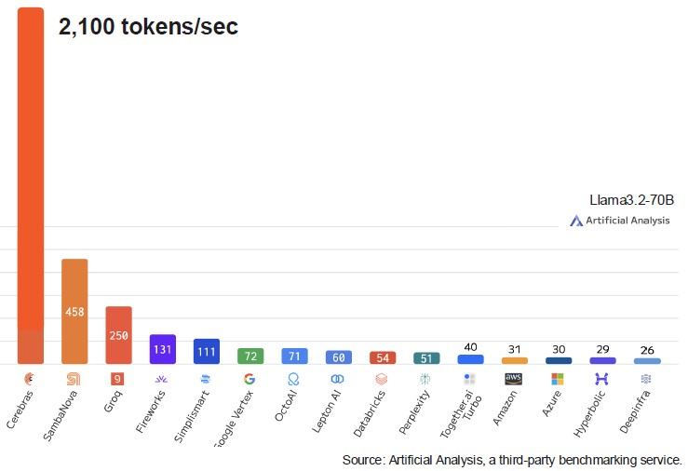
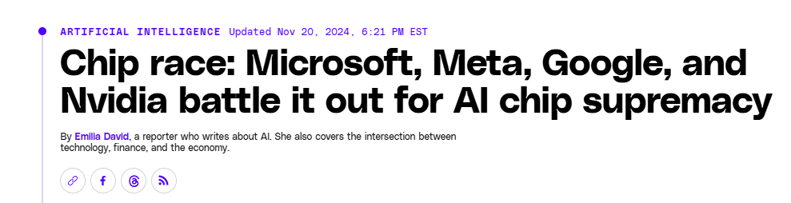
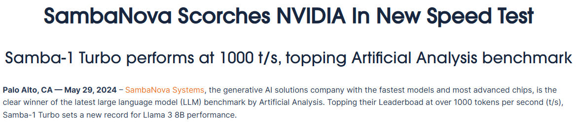
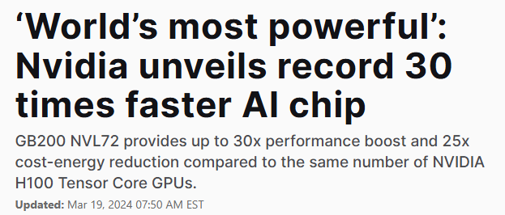
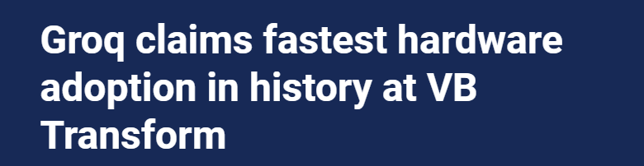
Surge in AI Hardware Accelerators

Slide 12
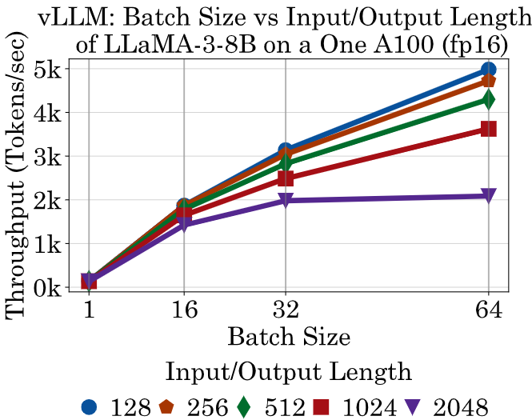
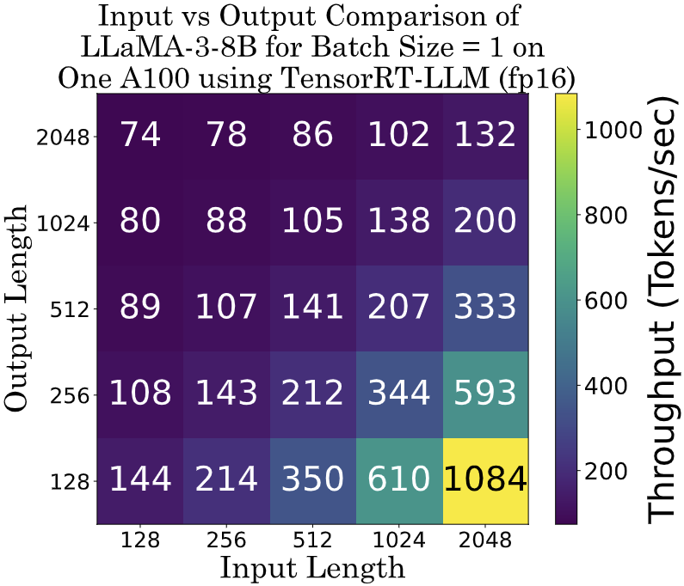
Impact of Batch Size, Input & Output Length
Batch Size: Throughput increases with increase in the batch size until memory and compute are saturated
This is due to the parallel computing nature of hardware to process batches in parallel
Input Length: Throughput increases with increase in the size of input length
This is due to the parallel computing of input sequence
Output Length: Throughput decreases with increase in the size of output length
This is due to sequential generation of output tokens based on all the previous tokens

Slide 13
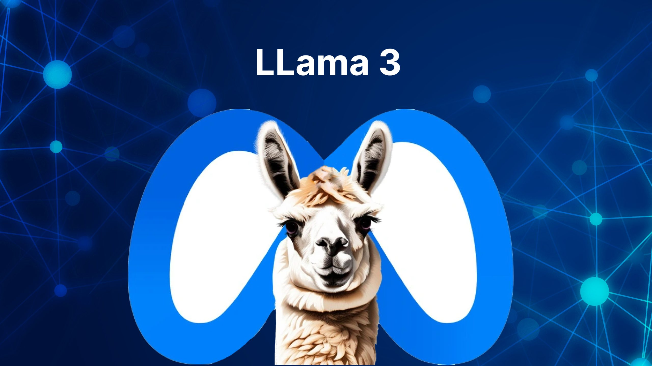

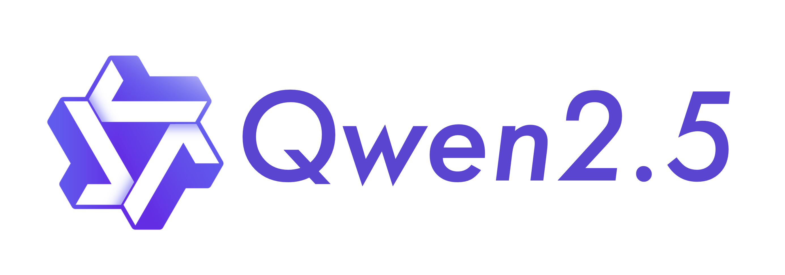
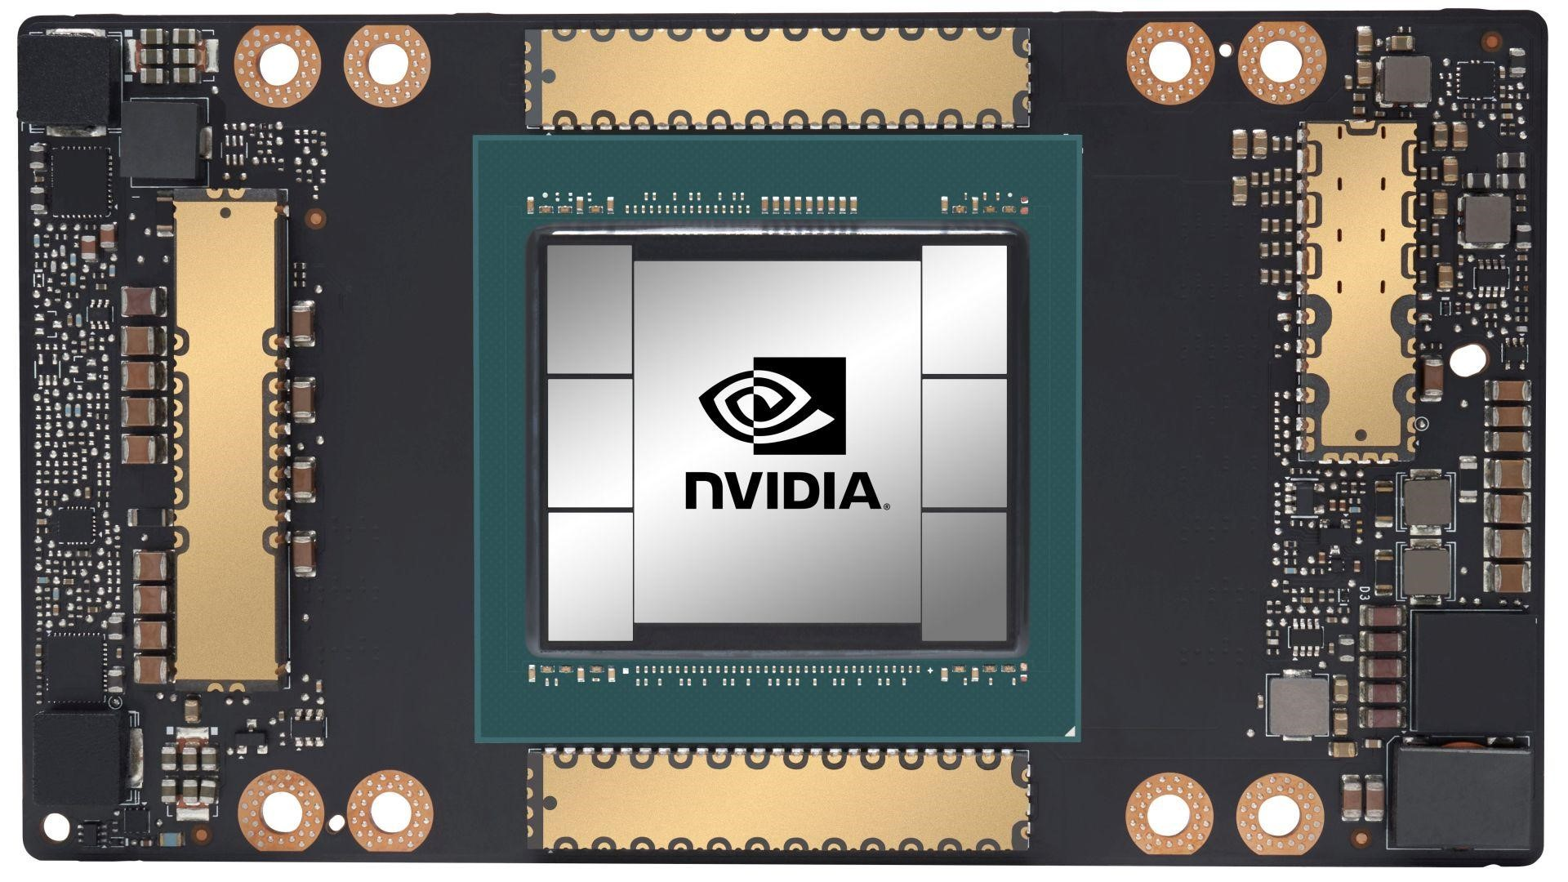
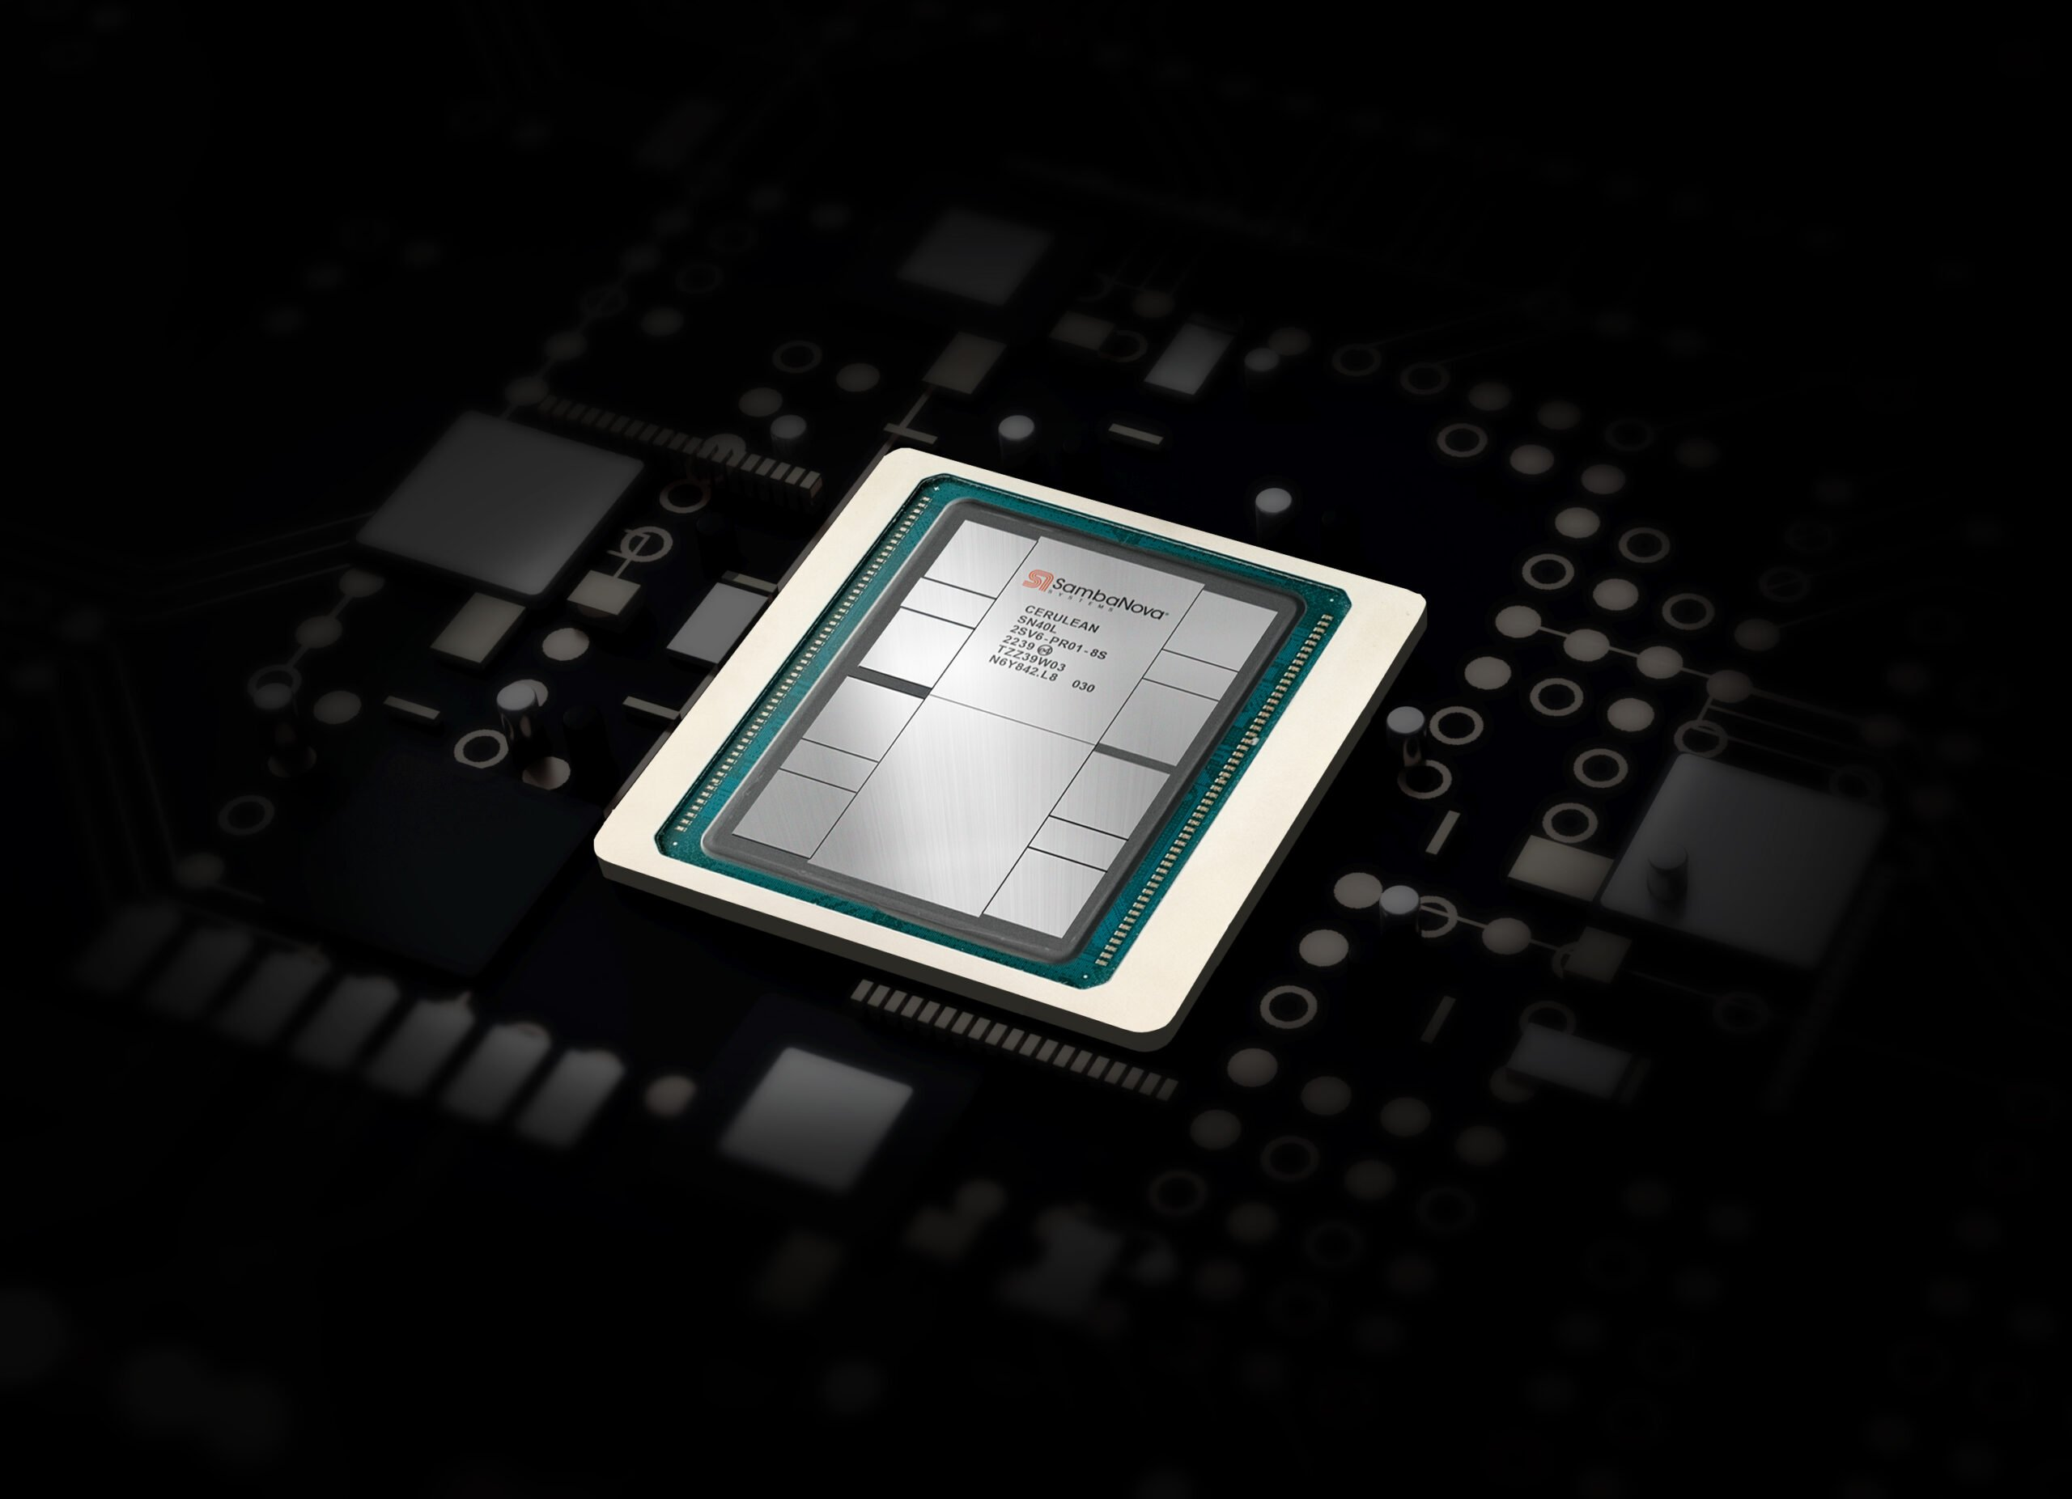

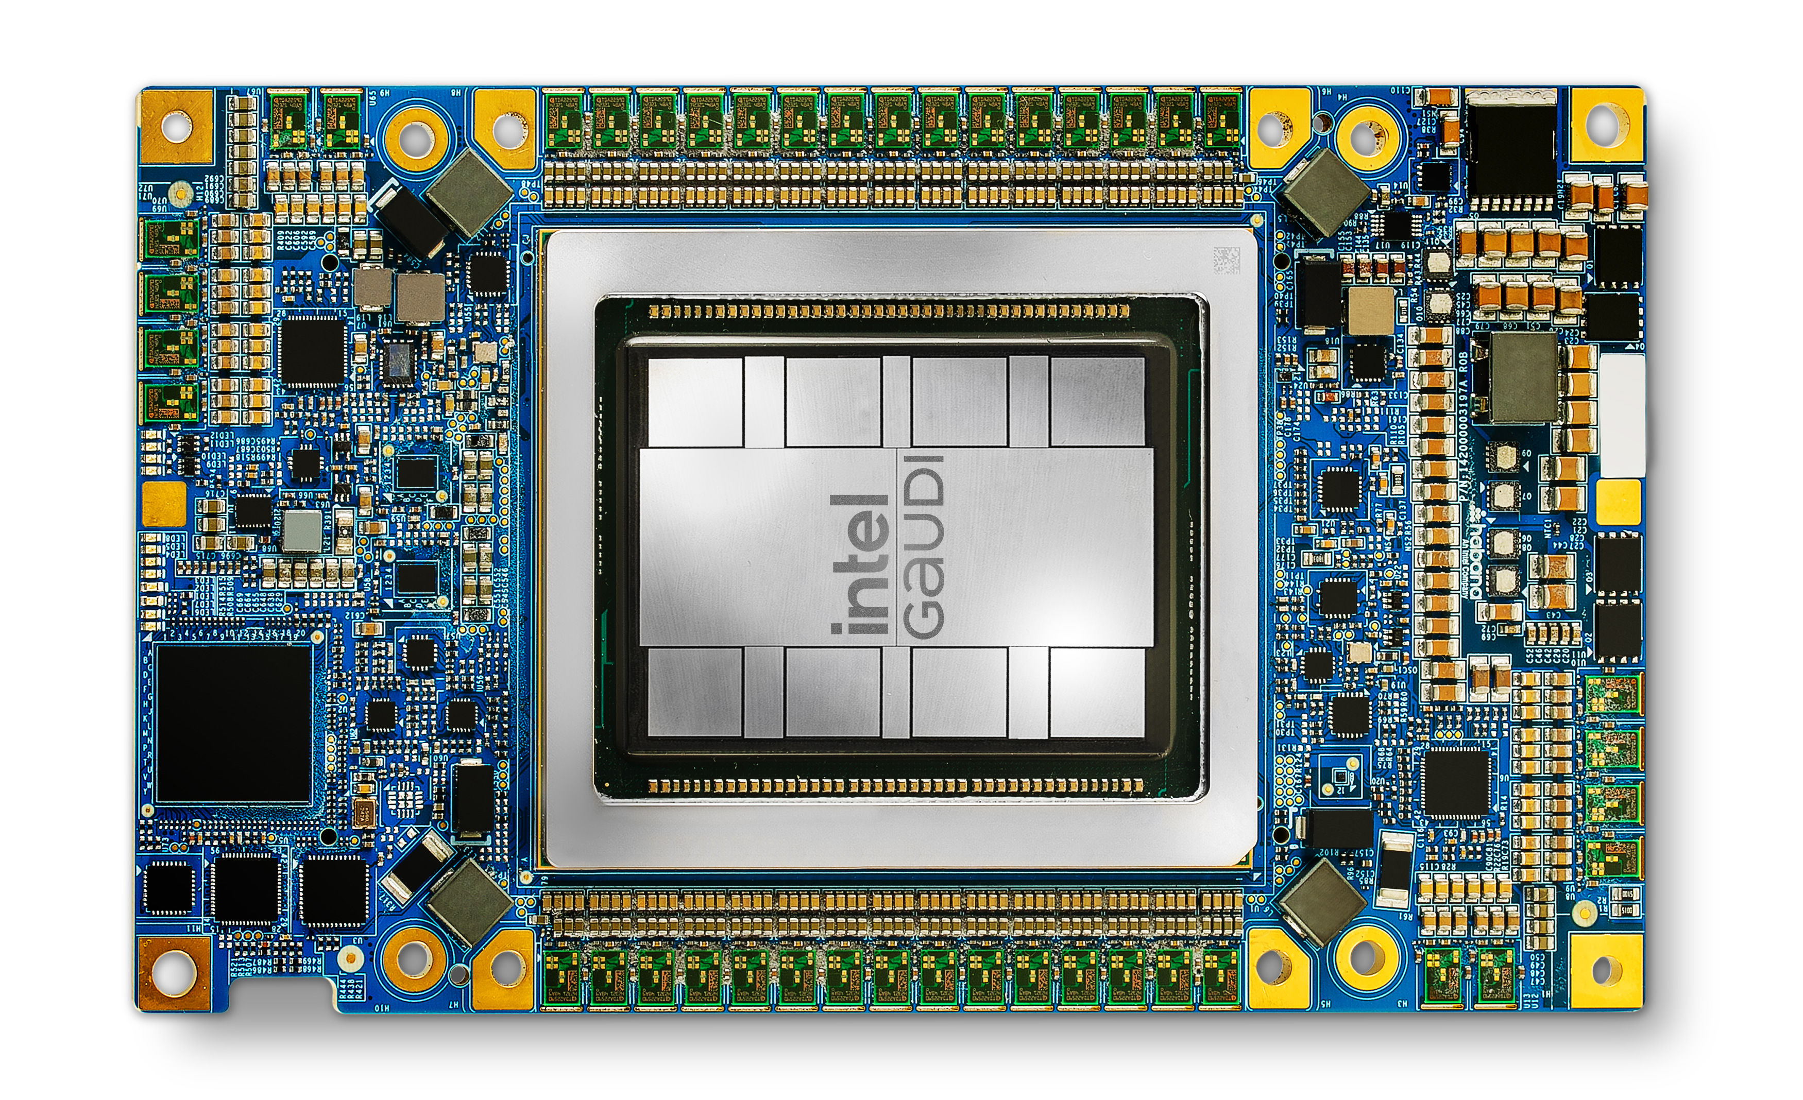

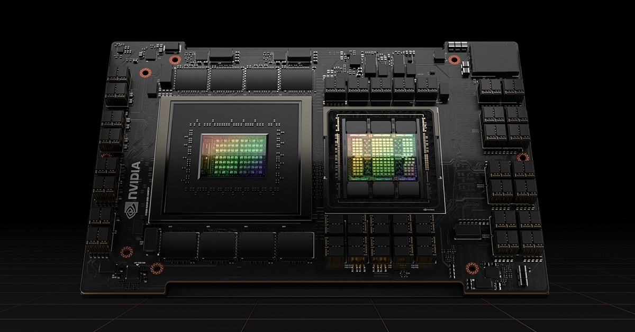
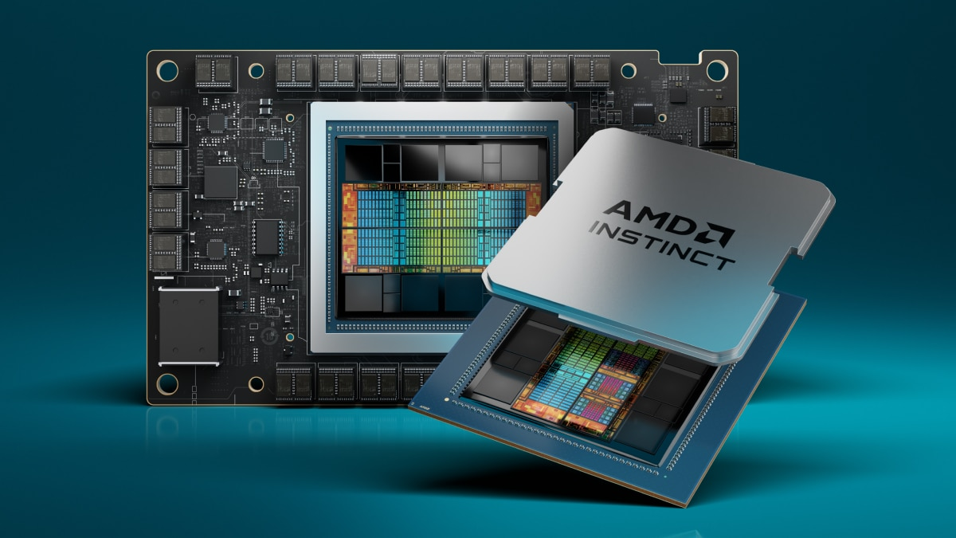


LLM-Inference-Bench: Bridging LLMs, Accelerators and Frameworks
Open source LLMs LLaMA, Mistral, Qwen
AI Accelerators
Nvidia, AMD GPUs, SambaNova SN40L, Habana Gaudi
LLM-Inference-Bench
TensorRT-LLM

Slide 14
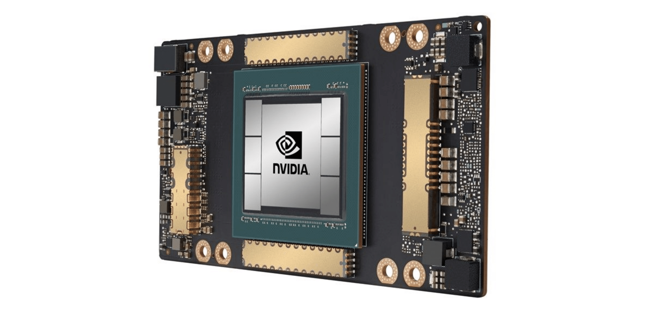
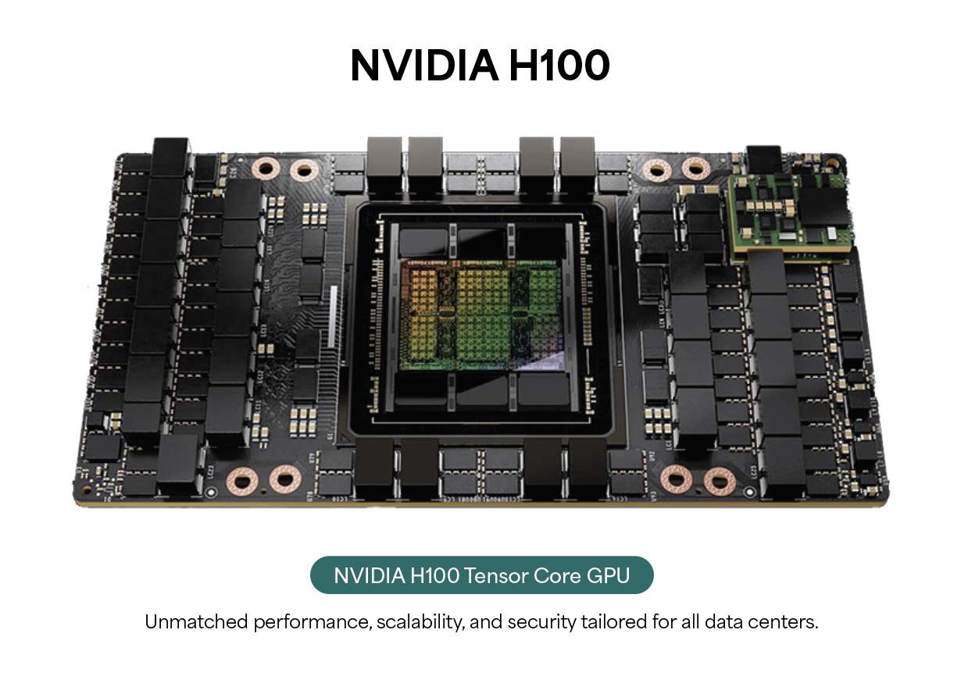
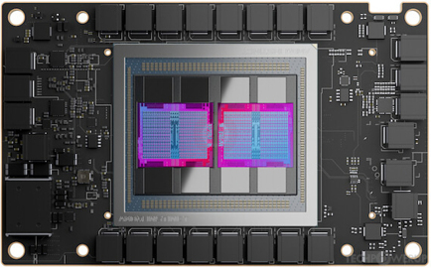
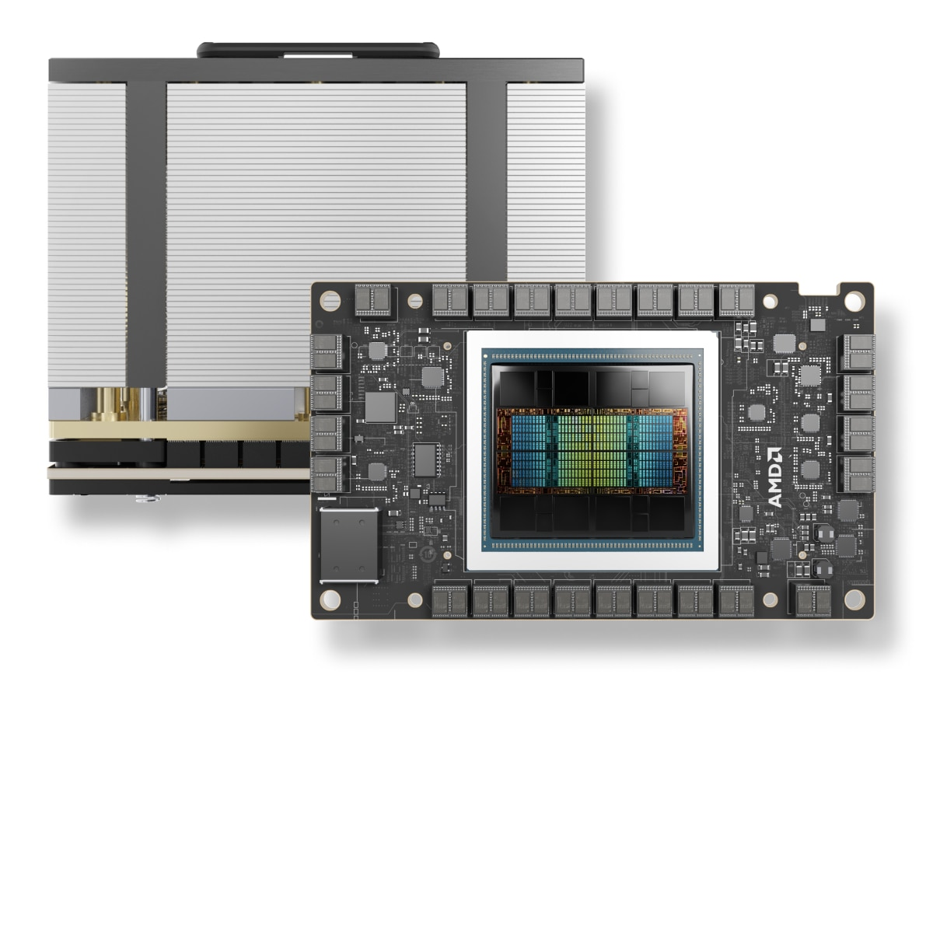
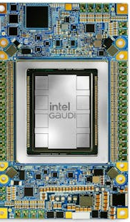

AI Accelerators for LLMs
AI Accelerators for LLMs are key to handle billions and trillions of LLM parameters
We consider the following Accelerators in our benchmarking study:
Nvidia GPUs: A100, H100 and GH200
AMD GPUs: MI300X and MI250
AI accelerators: SambaNova SN40L and Habana Gaudi2
Nvidia GPUs
AMD GPUs
AI Accelerators
A100
H100
GH200
MI250
MI300X
SambaNova SN40L
Habana Gaudi2
Notes:
Add line about dennard scaling ending and need of ai acceleratros to keep moorels law going

Slide 15

Open Source LLMs
LLaMA-2-7B
MHSA
LLaMA-3-8B
7B Models
Mistral-7B
GQA
Qwen-2-7B
Large Language Models (LLMs)
LLaMA-2-70B
LLaMA-3-70B
Dense Models
Large Models
Qwen-2-72B
Mixtral-8x7B
MoE

Slide 16
Classification of LLM Inference Methods
Type of Inference Optimizations
Efficient Transformer Neural Network Design
LLM Algorithm Optimization Methods
Hardware and memory management Techniques
Group Query Attention (GQA)
Mixture of Experts (MoE)
Pruning
Quantization
KV Caching
Speculative Decoding
PaggedAttention
Parallelism Methods
Tensor
Pipeline
Expert
Hybrid

Slide 17
Classification of LLM Inference Methods
Type of Inference Optimizations
Efficient Transformer Neural Network Design
Group Query Attention (GQA)
Mixture of Experts (MoE)

Slide 18
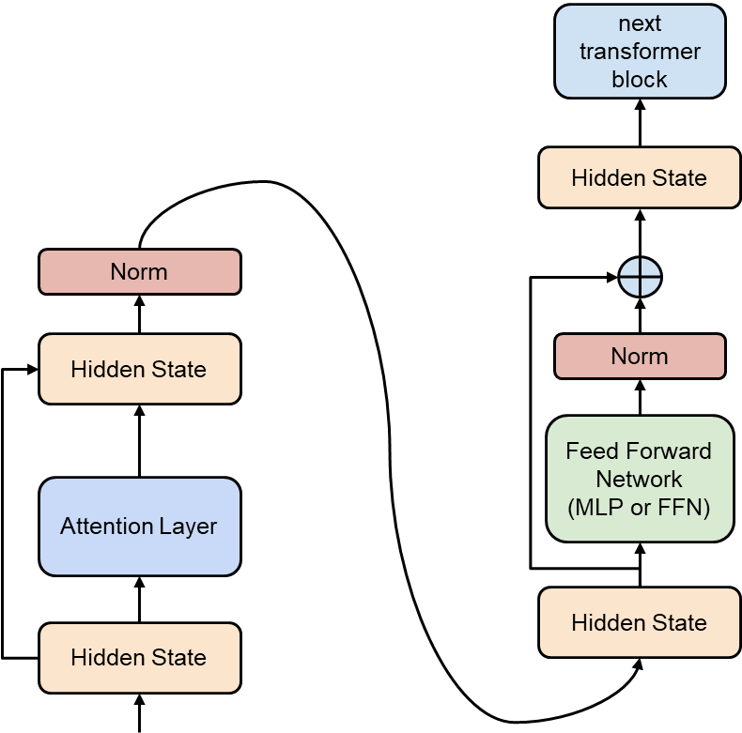
Transformer Model
Transformer Neural Network is comprised of two important layers:
Attention Layer
Feed Forward Network (FFN)

Slide 19
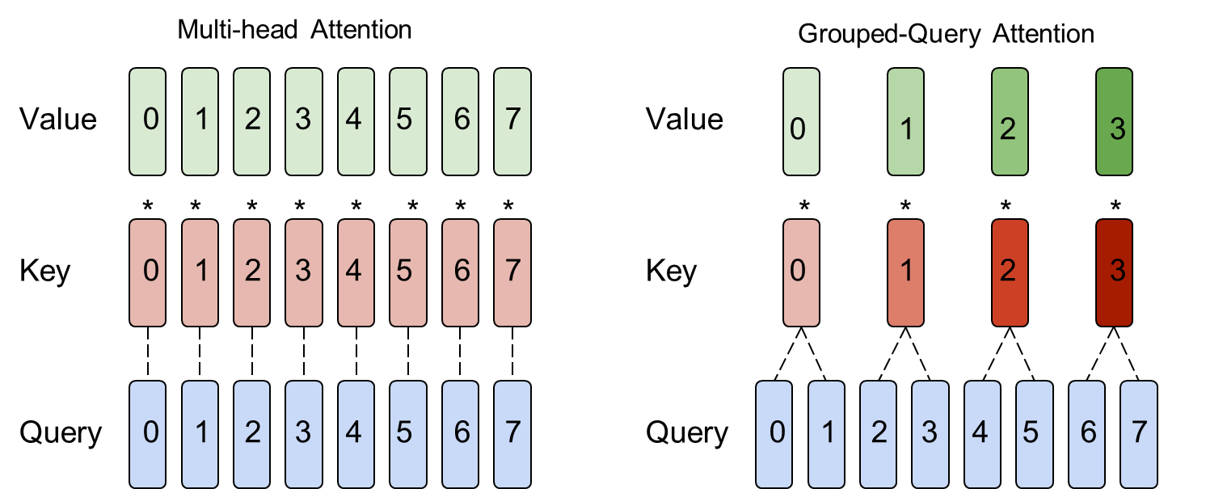
Multi-head Attention (MHA) vs Group Query Attention (GQA)
8 Query, Key and Value Heads
8 Query heads and 4 Key & Value Heads
GQA reduces memory and compute by a factor of "group size"

Slide 20
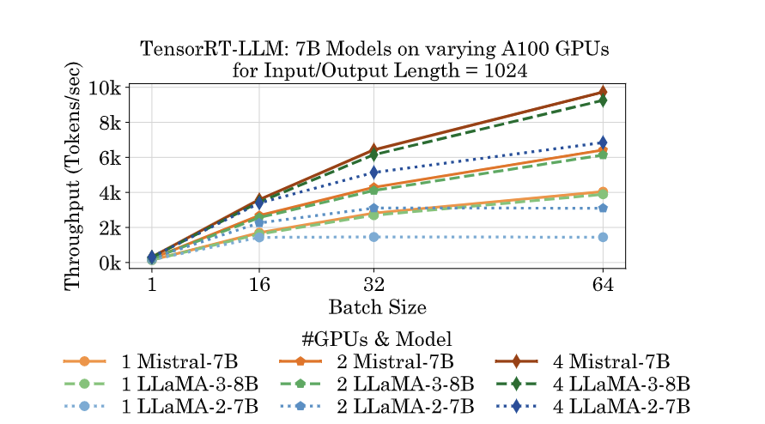
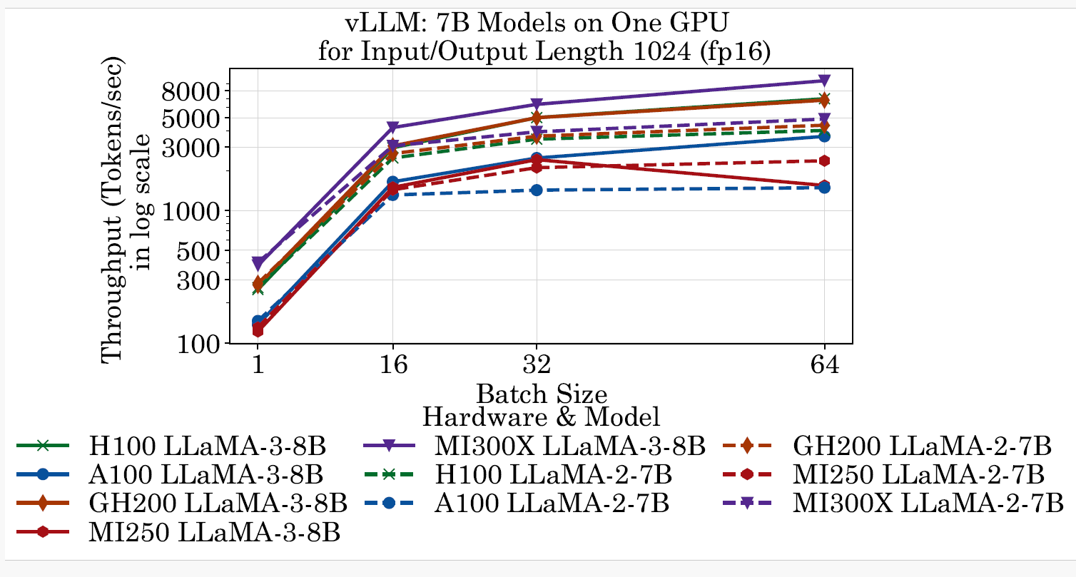
MHSA vs GQA Comparison
MHSA is slower than GQA due to less number of KV heads and KV Cache
Mistral-7B (GQA) > LLaMA-3-8B (GQA) > LLaMA-2-7B (MHSA)
vLLM and TensorRT-LLM frameworks demonstrate improved performance using GQA models

Slide 21
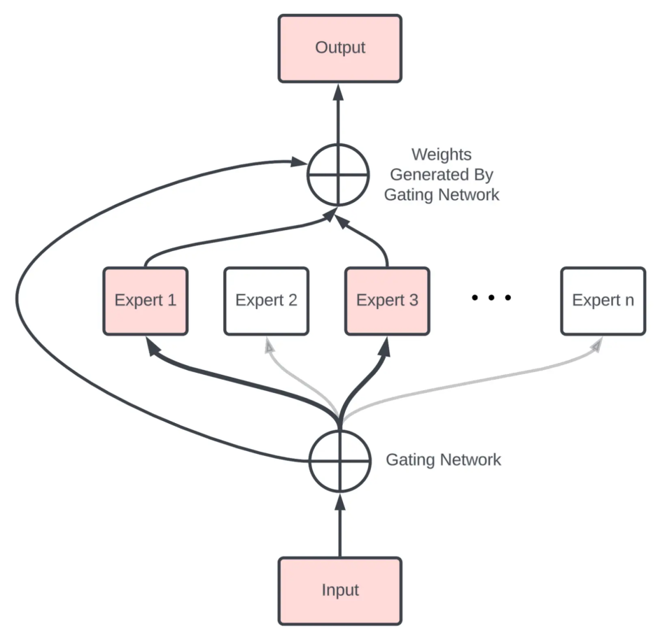
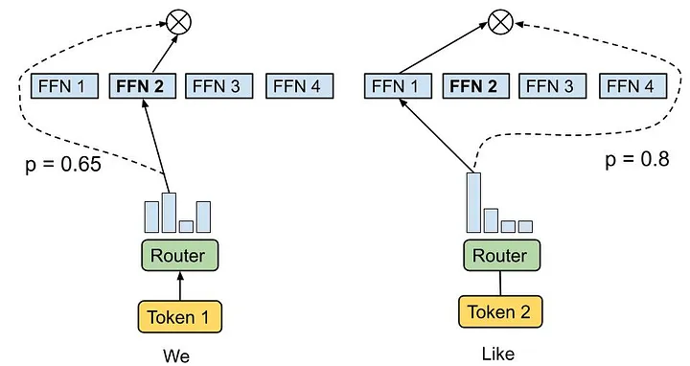
Mixture of Experts (MoE)
Dense Models: Dense LLMs are the traditional layer-by-layer transformer models connected in series
Mixture-of-Experts (MoE): MoE employs a combination of specialized sub-networks called experts and a gating mechanism to selectively activate only a subset of parameters for each input
In a regular dense LLM, all parameters are active while in MoE only a few model weights are utilized
Example: Mixtral-8x7B, GPT-MoE 1.8T
MoE Model
Dense Model
Layer 3
Layer 2
Layer 1
Input
https://deepgram.com/learn/mixture-of-experts-ml-model-guide

Slide 22
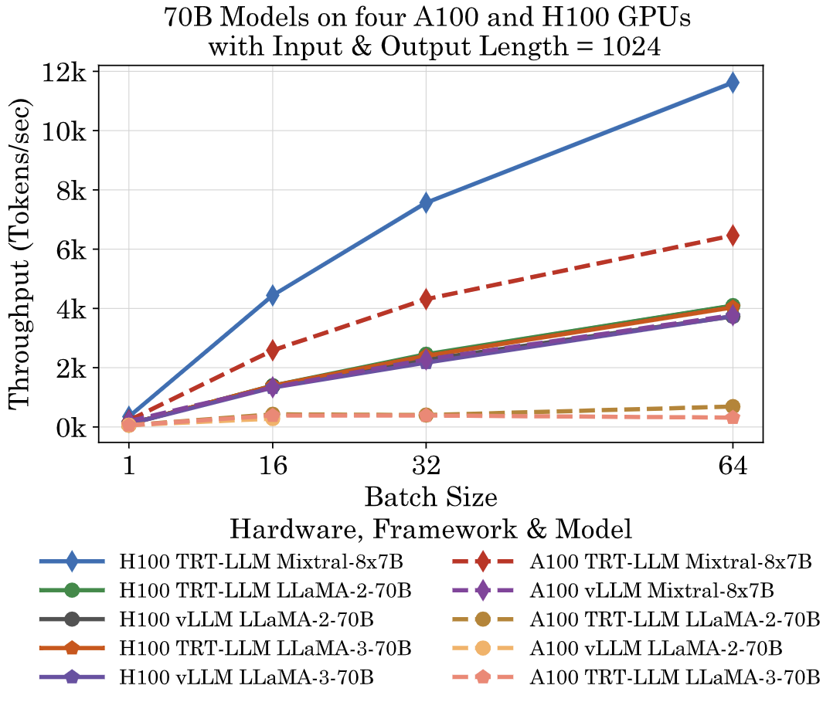
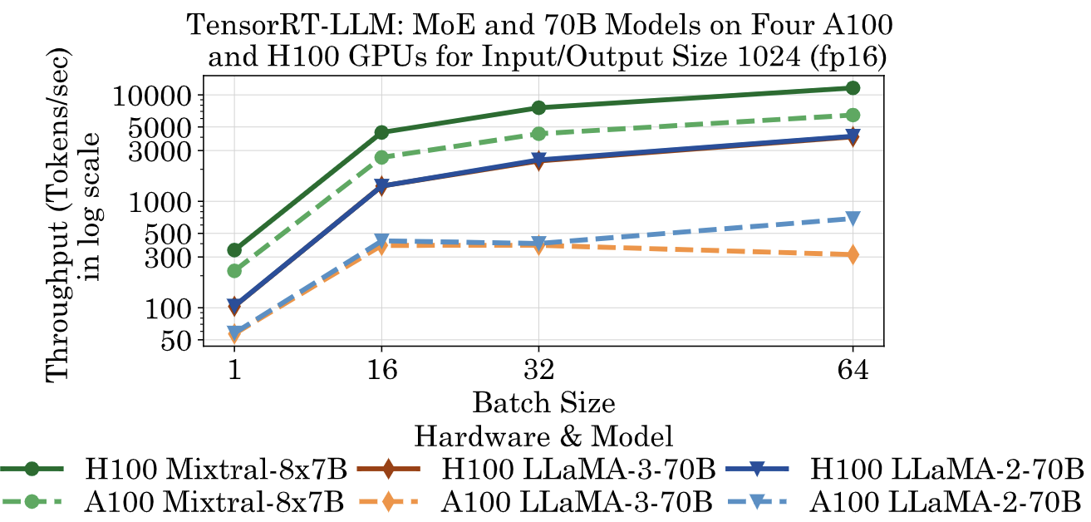
MoE vs Dense LLMs
Mixture of Experts (MoE) models are faster than Dense models for the similar parameter sizes due to less number of active parameters during inference.
Mixtral-8x7B (MoE) > LLaMA-2-70B (Dense) > LLaMA-3-70B (Dense)
vLLM and TensorRT-LLM frameworks demonstrate improved performance using MoE models

Slide 23
LLM-Inference-Bench: Bridging LLMs, Accelerators and Frameworks
Open source LLMs LLaMA, Mistral, Qwen
AI Accelerators
Nvidia, AMD GPUs, SambaNova SN40L, Habana Gaudi
LLM-Inference-Bench
TensorRT-LLM

Slide 24
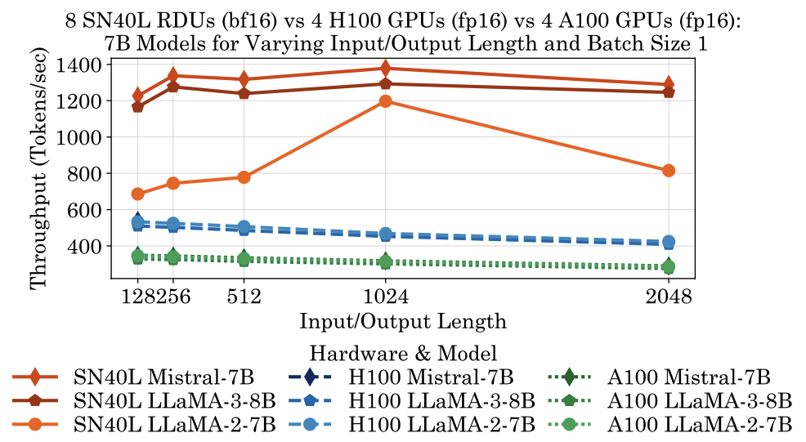
Model Comparison
7B Models
Mistral-7B performs better than LLaMA-3-8B due to one billion less parameters
LLaMA-3-8B performs better than LLaMA-2-7B due to Group Query Attention (GQA) despite one billion more parameters
Large Models
Mixtral-8x7B performs better than LLaMA-3-70B and LLaMA-2-70B due to mixture of experts layer utilizing less active parameters
LLaMA-2-70B performs better than LLaMA-3-70B due to smaller vocabulary size

Slide 25
LLM-Inference-Bench: Bridging LLMs, Accelerators and Frameworks
Open source LLMs LLaMA, Mistral, Qwen
AI Accelerators
Nvidia, AMD GPUs, SambaNova SN40L, Habana Gaudi
LLM-Inference-Bench
TensorRT-LLM

Slide 26
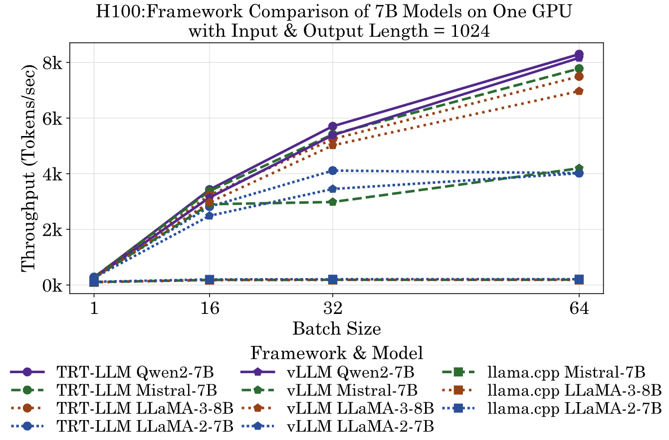
Framework Comparison
TensorRT-LLM attains the highest throughput on Nvidia GPUs across different Large Language Models
vLLM is the second best performer
llama.cpp shows least performance due to lack of efficient transformer algorithm methods such as GQA and PaggedAttention
Notes:
This is due to less number of neural architecture hyperparameters for Qwen2-7B, such as numbers of layers, hidden size, and FFN dimension, compared to other models.

Slide 27
LLM-Inference-Bench: Bridging LLMs, Accelerators and Frameworks
Open source LLMs LLaMA, Mistral, Qwen
AI Accelerators
Nvidia, AMD GPUs, SambaNova SN40L, Habana Gaudi
LLM-Inference-Bench
TensorRT-LLM

Slide 28
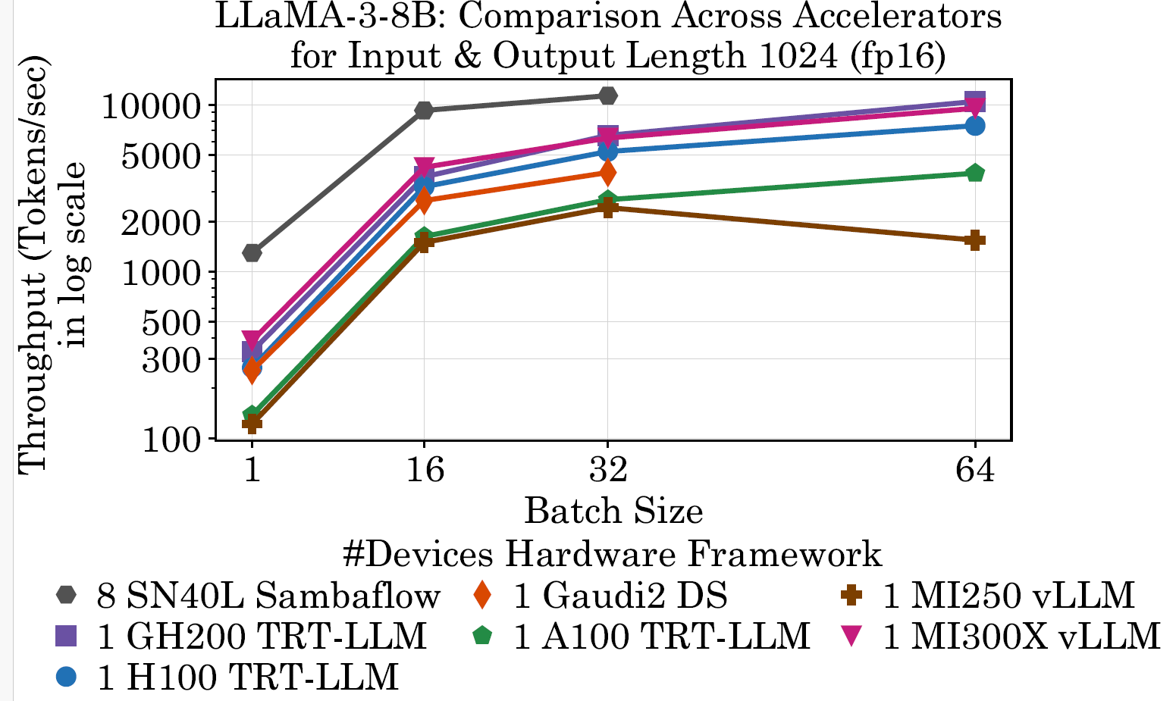
Accelerator Comparison
SambaNova SN40L achieves has the best performance among all the accelerators we benchmarked
However, as of July 2024, the maximum batch size SN40L supports is 32
Nvidia GH200 > H100 > A100 (in terms of throughput)
MI300X and GH200 are comparable
Habana Gaudi’s performance is between A100 and H100
The performance of AMD MI250 saturates for large batch sizes

Slide 29
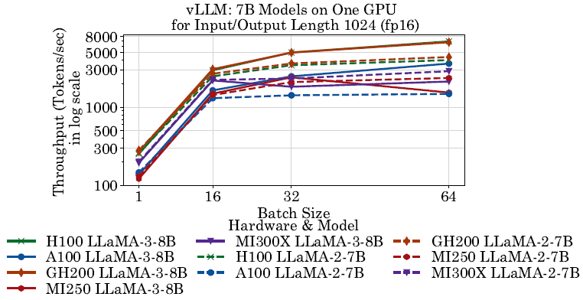
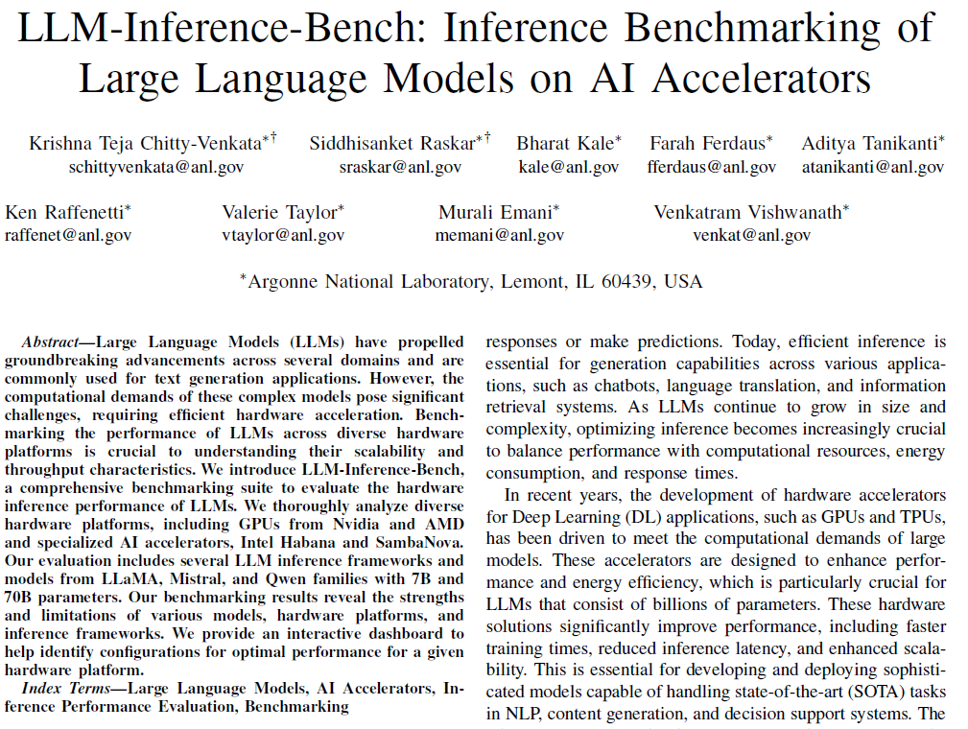
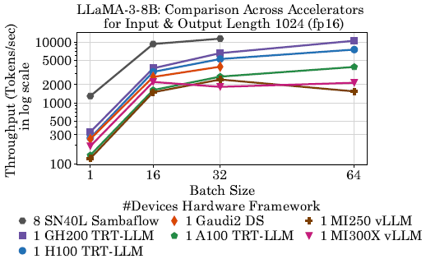
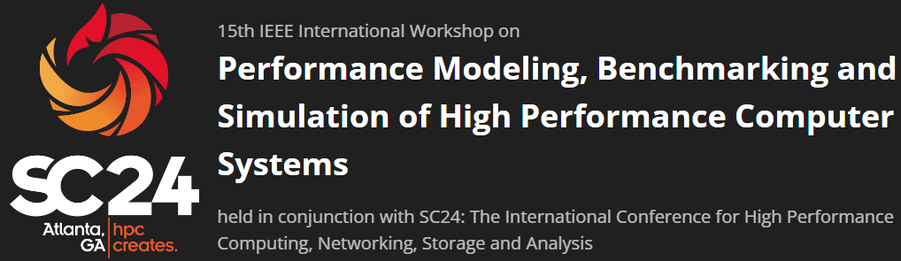
LLM Inference Publication

Slide 30
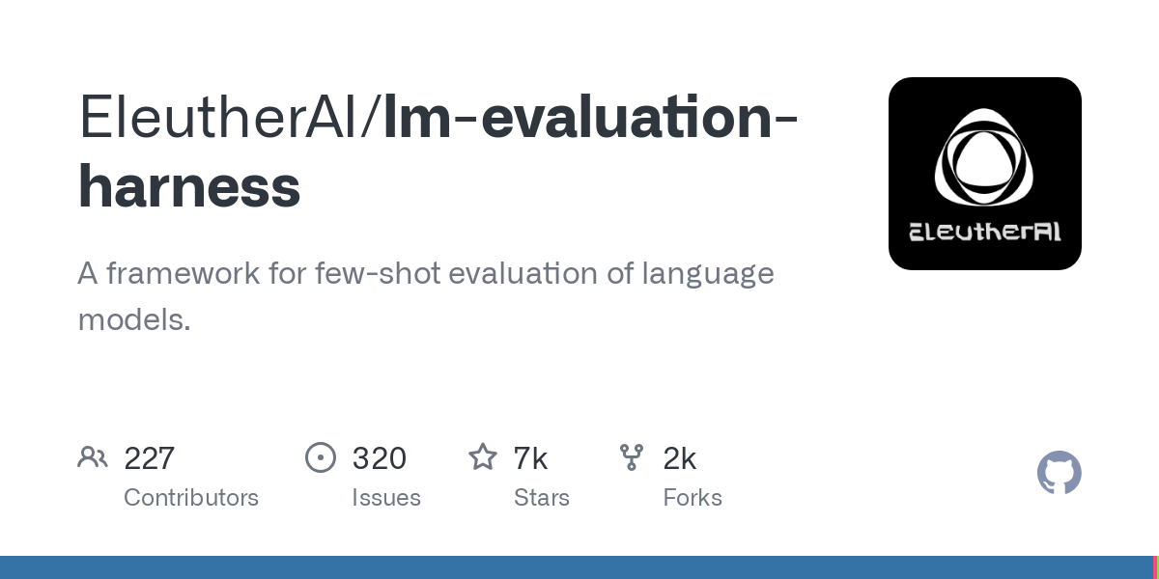
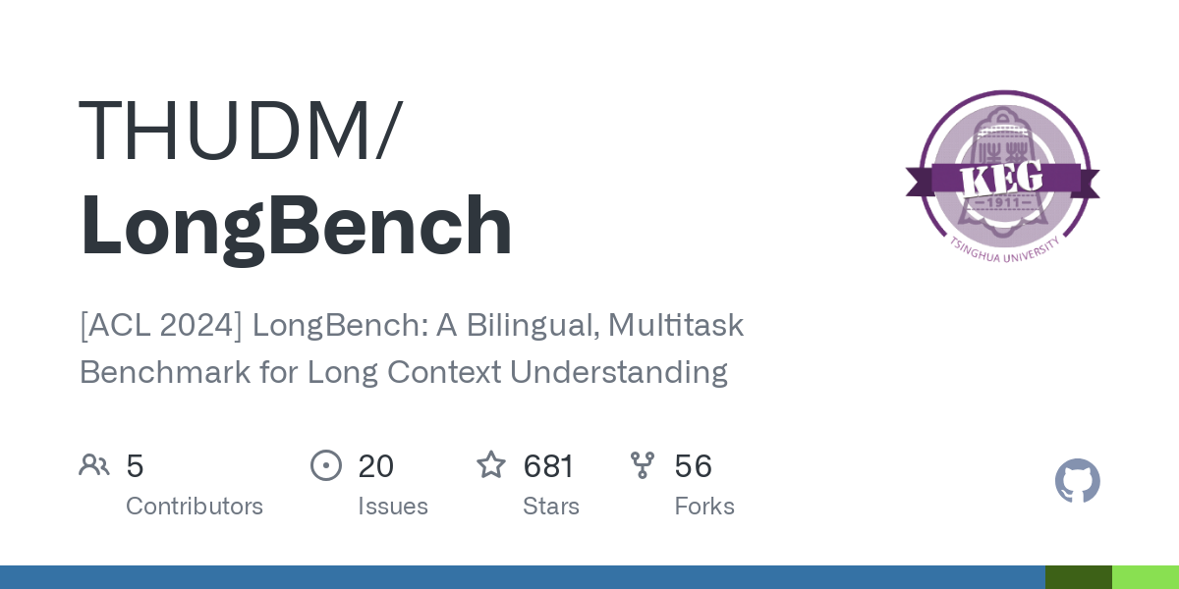
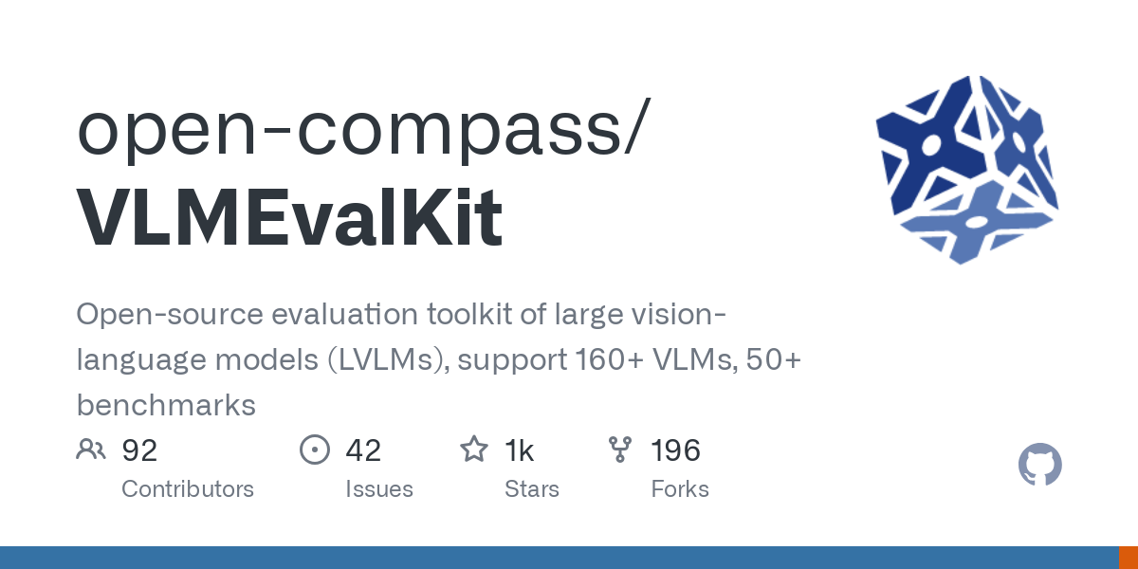
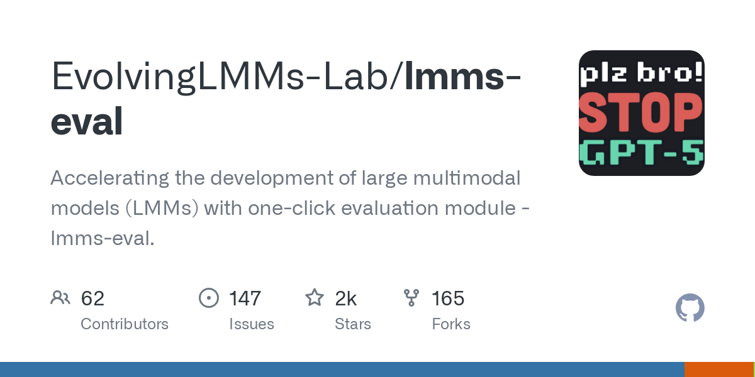
Rise in Evaluation Frameworks

Slide 31
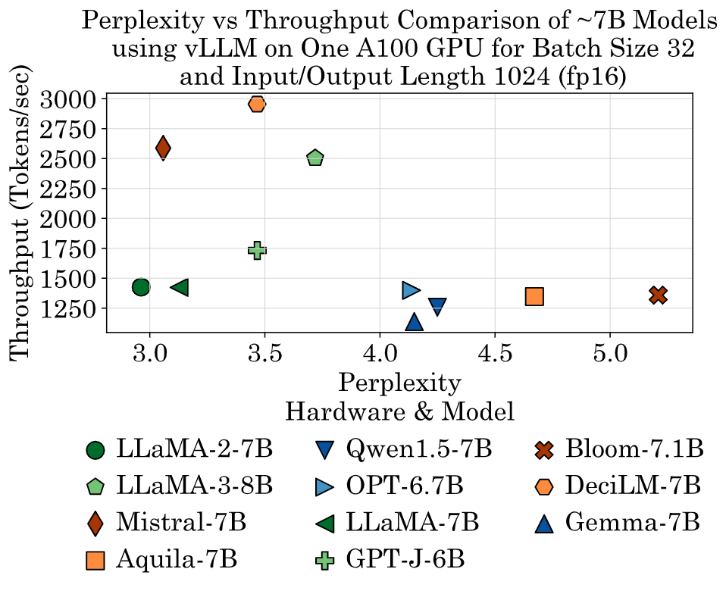
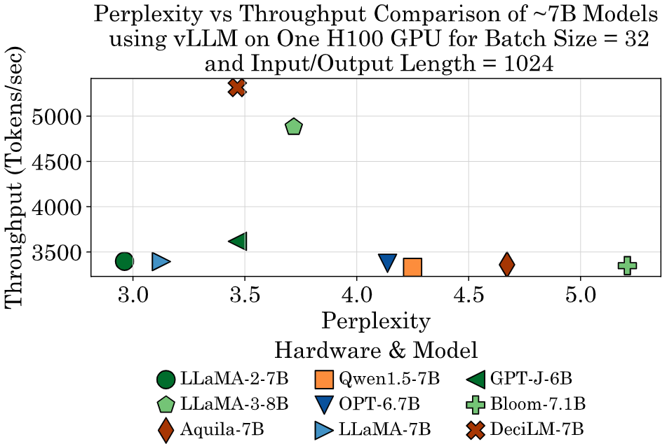
Perplexity vs Speed
Throughput (higher is better) vs Perplexity (lower is better)

Slide 32
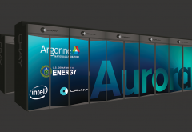
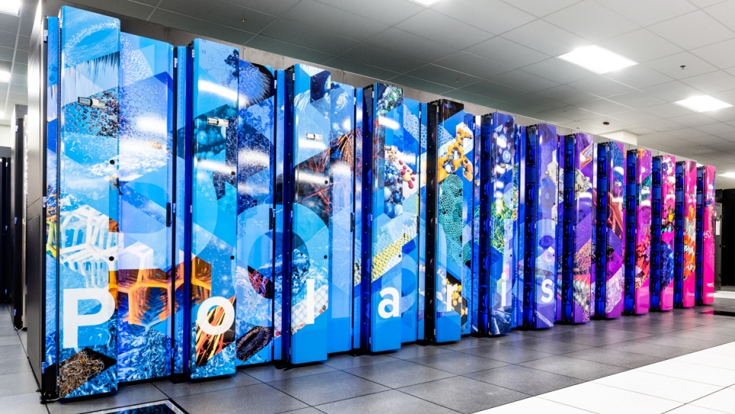



ALCF Resources

Slide 33




LLM Projects at Argonne National Lab
GenSLM:
Predicting next harmful COVID variants
AuroraGPT: ChatGPT for Science

Slide 34


Any Questions?

